Slide 1

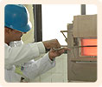
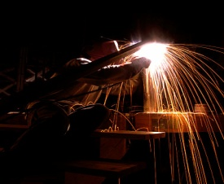
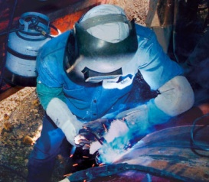
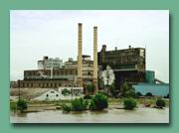
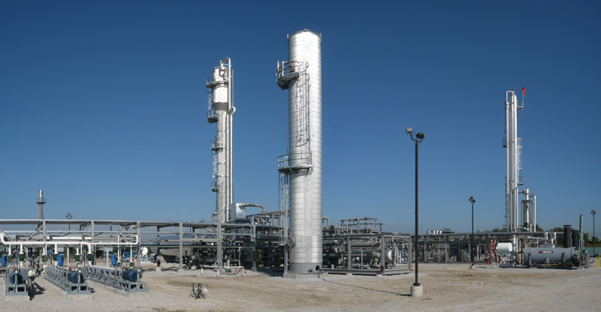
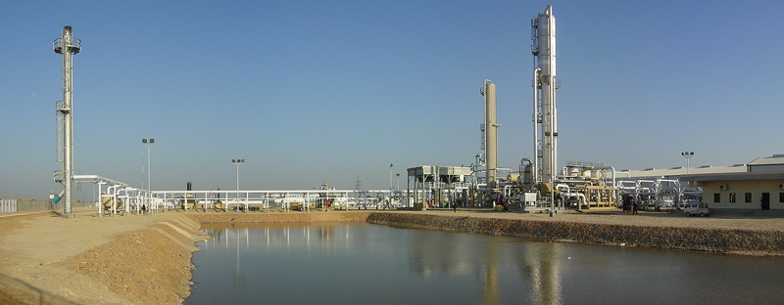
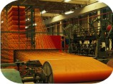

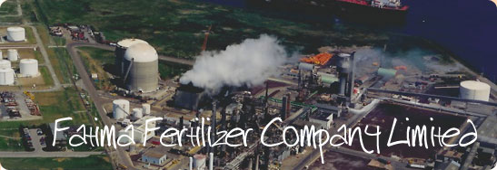
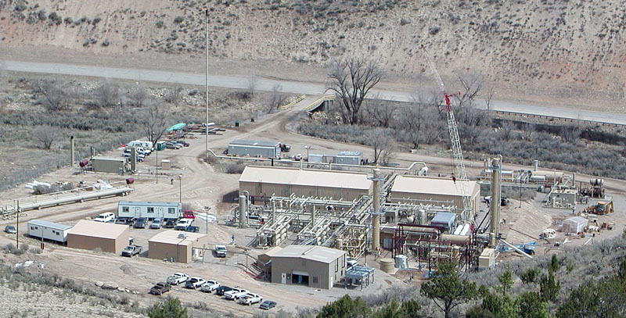

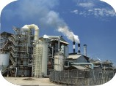

We are here for Success
PAK ASIA ENGINEERING
COMPANY

Slide 2
Concept in Formation & Business Sustainability
Coming from a rich heritage in building of an institution, from a very humble beginning to maturity, executive members of Pak Asia’s management team brings a cumulative professional experience of over 20 years and knowledge of project management in engineering and contracting business.
The concept of blending professional excellence with entrepreneurial drive has a very powerful impact in ensuring business success.
Learning from experience, Pak Asia Management firmly believes that client satisfaction is indeed the single most important factor for business success.
As professional owner, Pak Asia Management has “double the stakes” in ensuring success.
A win-win approach to genuine and enduring success!

Slide 3
Message from Chief Executive
It is my pleasure to introduce operations and activates of Pak Asia Engineering Company.
The company was founded in 1998 as a construction company with the object to undertake deferent engineering projects. Since then, it has branched off into new directions in the field of engineering & contracting. We enthusiastically participated and successfully executed to a diverse range of projects.
In the light of our technology experts and advanced management capabilities. We have set up office in Sadiqabad Dist. Rahim Yar Khan. We are proud to add that the company has successfully undertaking a large variety of projects in adherence to state-of-the art technology and strict international quality control standard.
We, at Pak Asia Engineering Company, with our high-charged engineering skills, technology and competent personnel guarantee you absolute success.
MANZOOR AHMAD
CHIEF EXECUTIVE

Slide 4
Vision and Mission
Our vision
“To be recognized as a reliable source for ensuring business success in delivering world class services and turn-key solutions at the most competitive price with best quality and reliability”
Our mission
“To become an exemplary engineering and contracting services company known for its project management skills, integrity and unflinching commitment of its entrepreneurial owner-employees, towards customers and other business associates, providing the best value to stakeholders”

Slide 5
Our Values
Trust
Honesty
Integrity
Courage
Respect with dignity
Prosperity for stakeholders including employees

Slide 6
QHSE Policy
Develop and integrate management system frame work
Assign accountability to all management levels
Understand and comply with applicable legal, regulatory & statutory standards
Apply systematic and measurable approach to continually improve upon our QHSE culture and performance
Implement structured training programs
Communicate this policy to stakeholders

Slide 7
Head Office Location
Permanent Establishments:
Head Office & Workshop:
Near Sadiqabad Polytechnic Institute Campus # II, By Pass Road Sadiqabad
Cell No: +92-300-6743326
Fax: +92-68-5033152
Email: manzoor_paec@yahoo.com

Slide 8
CERTIFICATES

Slide 9
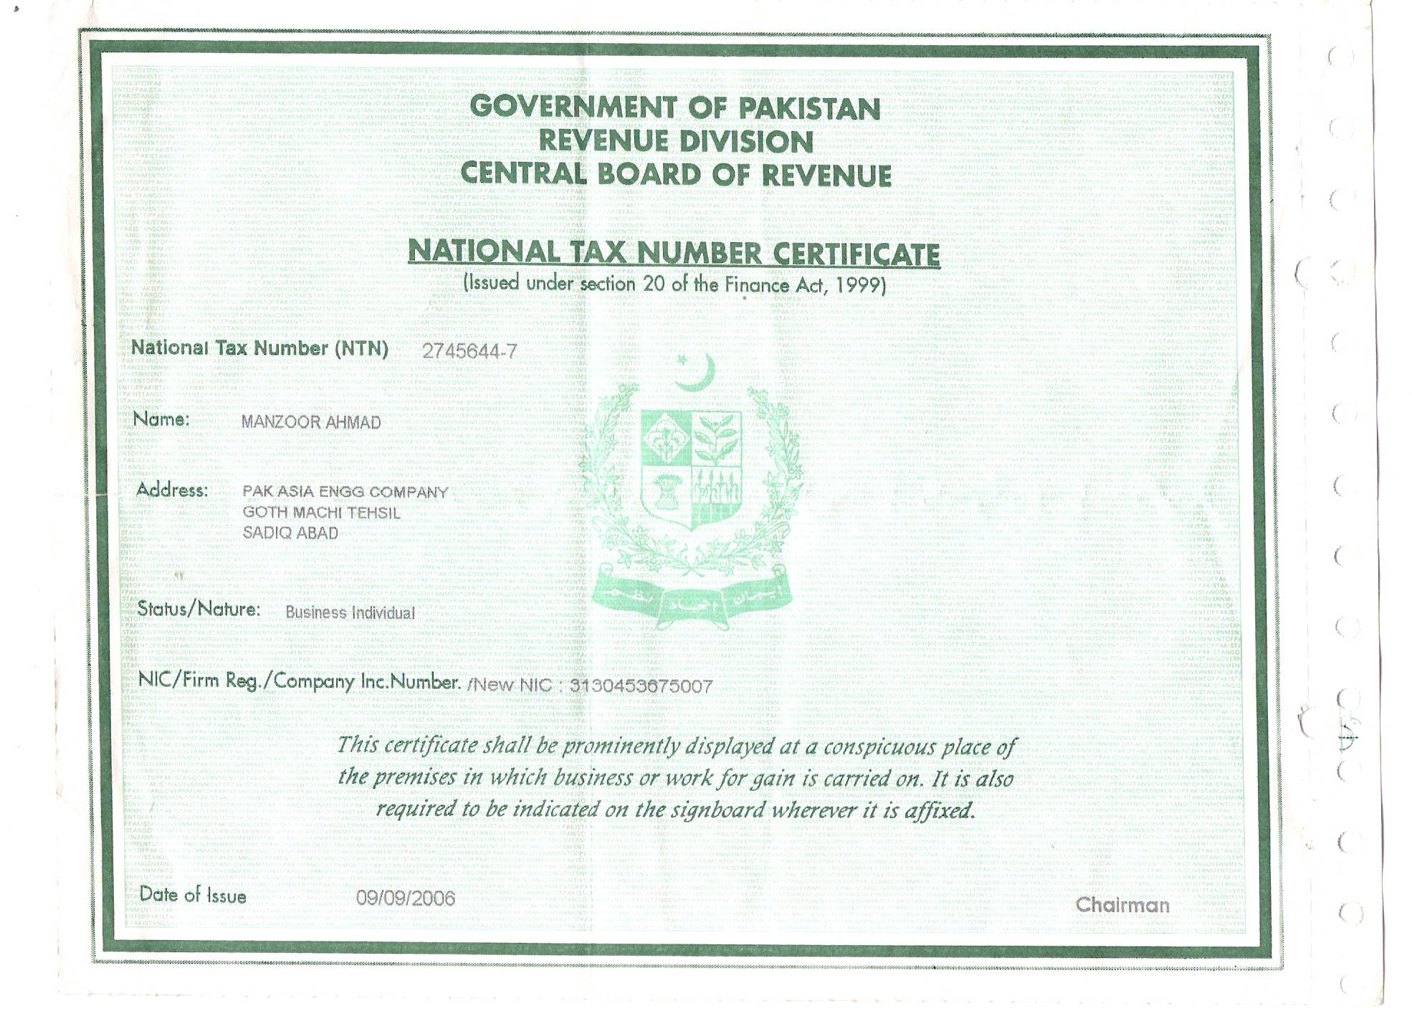
Certifications
Notes:
9

Slide 10
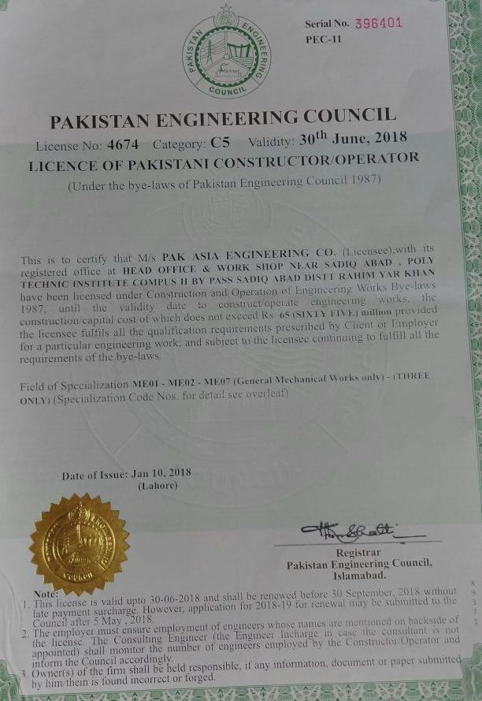
Certifications
Notes:
10

Slide 11
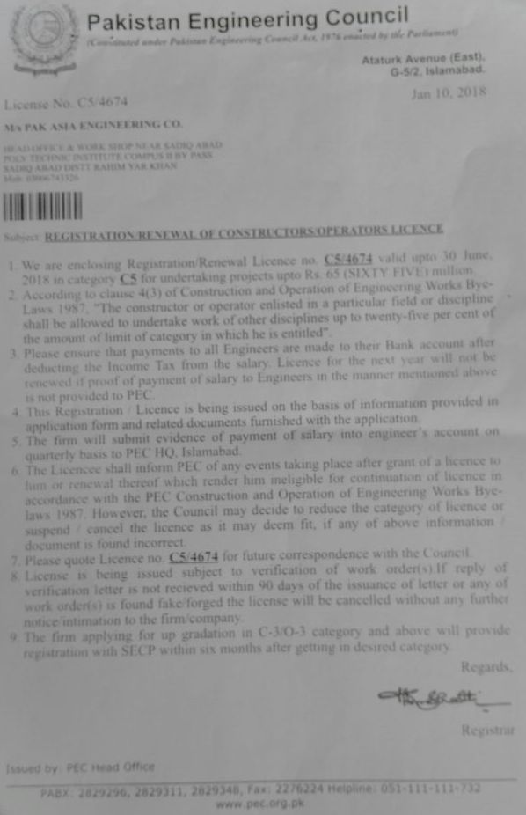
Certifications
Notes:
11

Slide 12
The Pak Asia Management Team our foremost asset
Chief Executive
Manzoor Ahmad
Manager Projects
Ishtiaq
Hussain
Pak Asia management team has rich experience and a proven track record of delivering projects exceeding customer’s satisfaction
Site Manager
Muhammad Nawaz
QA/QC Manager
Faisal Zulfiqar
We enjoy unmatchable market reputation in our industry as first class professionals with excellent entrepreneurial skills and with a mission “to deliver”
I/C Planning
Irfan Ul Haq
Commercial Manager
Muhammad Waseem
Material Co-ordinator
Muhammad Arshad
Accounts
Manager
Muhammad Adil
Manager Admin.
Rana Tahir
Notes:
12

Slide 13
Team Pak Asia
Management Staff
10 Nos.
Engineers
02 Nos.
Skilled & Unskilled Staff
100 Nos.
Equipment Operators
05 Nos.
Labor
As per site requirement
Technical Staff and Labor other then mentioned above shall be
hired as per requirement of project / projects

Slide 14
Organization Chart
Managing
Director
Finance
Manager
Accountants
Planning
Manager
Planning
Engineers
Rental Services
Tool &
Equipment
Electrical
Equipment
Manager
Projects
All site staff
Procurement
Buyer &
Expediters
QHSE
Inspectors
Notes:
14

Slide 15
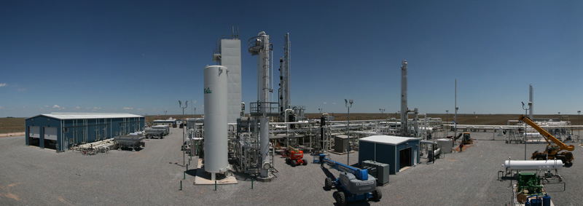
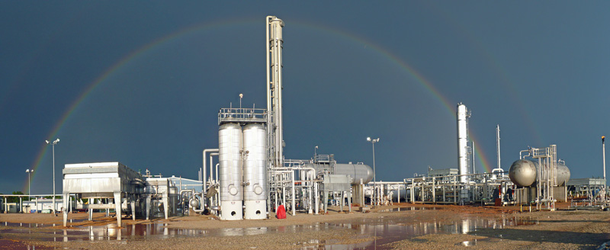
What We Offer
Over the last 20 years, Pak Asia team has successfully executed Mechanical, Civil, E&I projects in Oil & Gas, Petrochemical and Power Sectors etc.
Turnkey Solutions
Construction (Civil & Mechanical)
Complete shutdown and turnaround maintenance services
Plant Modification and Revamp Solutions
Asset Development

Slide 16
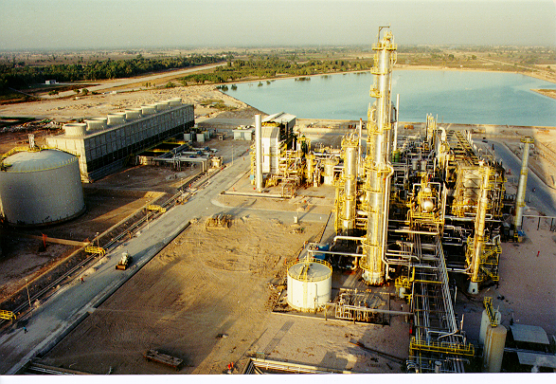
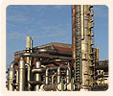
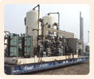
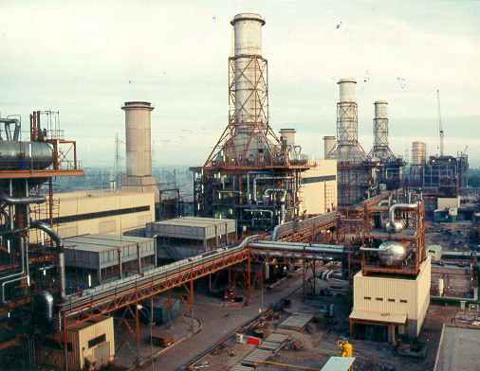
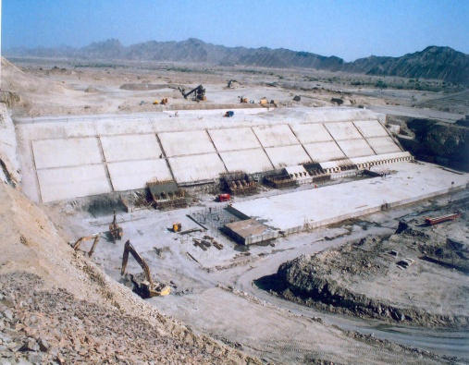
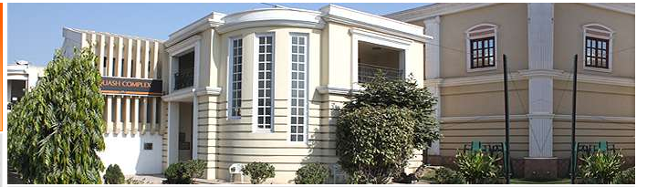
Business Sectors
Oil & Gas
Chemical / Petrochemical
Power
Water Treatment
Building & Infrastructure

Slide 17
Oil & Gas
Gas processing and production facilities
Oil refining, treatment and separation
LNG and LPG recovery
Wellhead facilities and flow lines
Gas compressor stations
Tank farms and loading/unloading facilities
Utilities and offsite facilities

Slide 18
Chemical/Petrochemical
Fertilizer
Cement
PTA, PVC, Olefins , Poly-olefins
Tank farm and storage facilities (Liquid and Gas handling)
Soda Ash
Hydrogen peroxide
Chloralkali

Slide 19
Power
Bagasse based Power Plant(Co-generation)
Combined Cycle Power Plant
Retrofit & Up-gradation of Power Plant
Simple Cycle Power Plant

Slide 20
Water Treatment
Surface water treatment (Potable)
Demineralization
Desalination unit
Municipal waste water treatment
Industrial waste water treatment

Slide 21
Building & Infrastructure
Excavation
Piling
Concreting
Architectural work

Slide 22
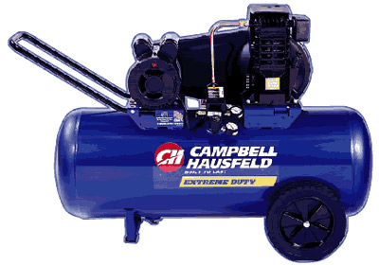
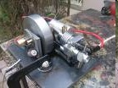
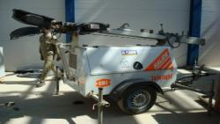
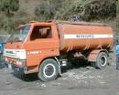
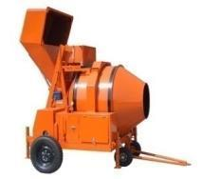
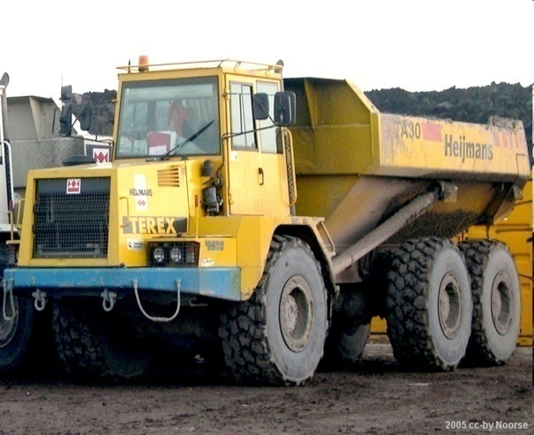
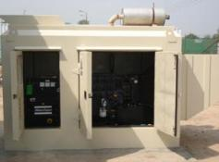
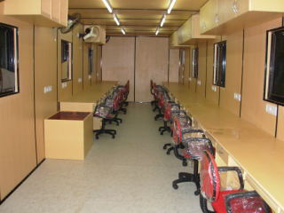
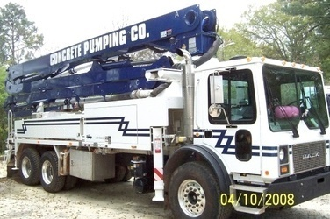
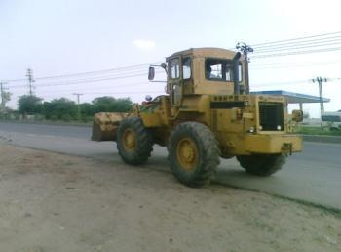
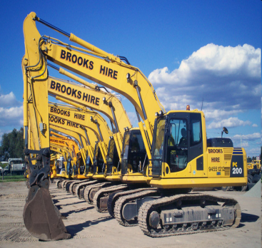
Construction Equipment

Slide 23
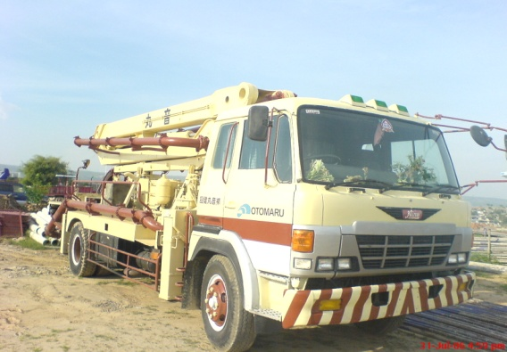
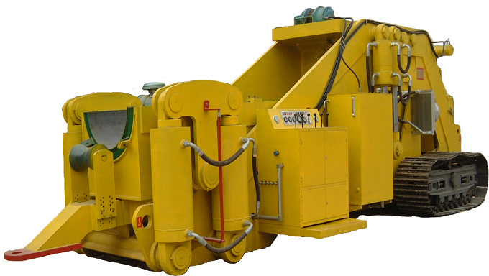
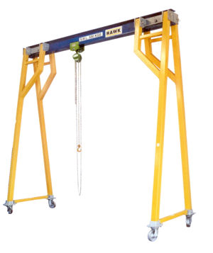
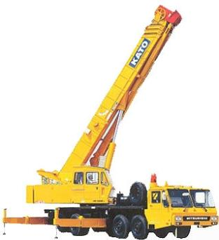
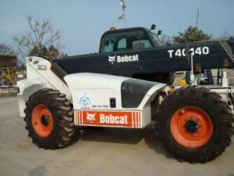
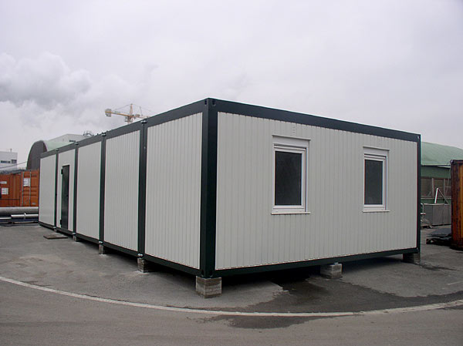

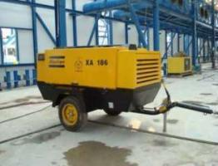
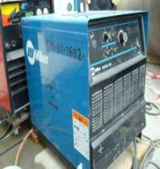
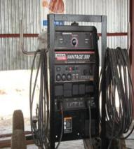
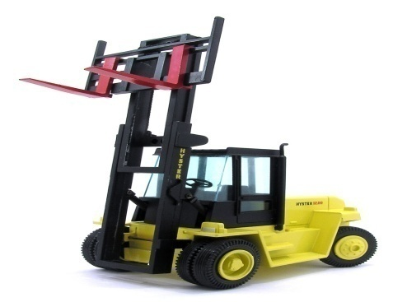
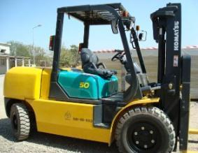
Construction Equipment

Slide 24
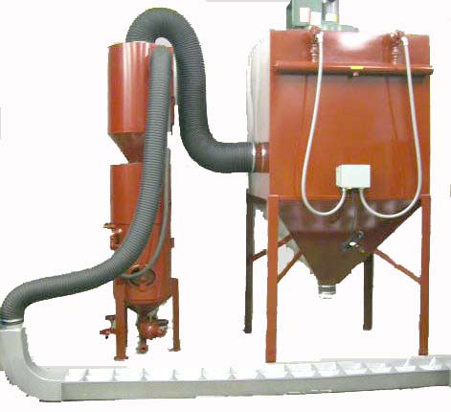
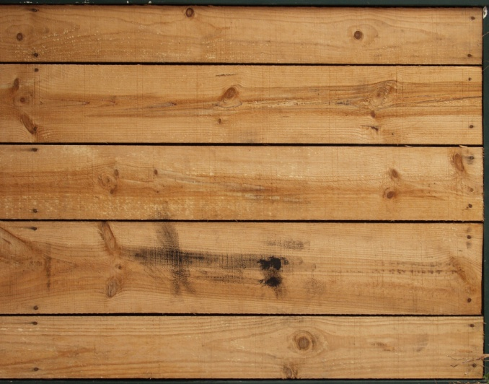
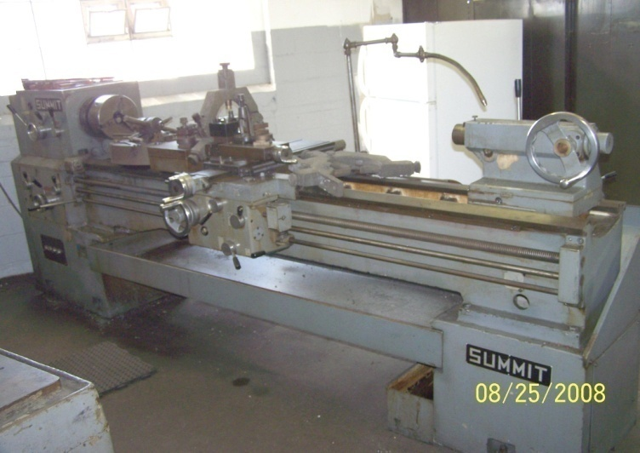
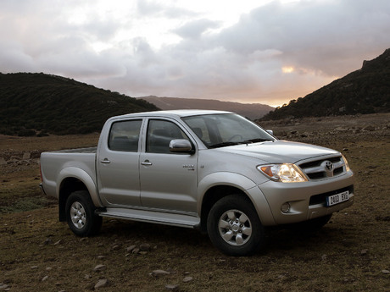
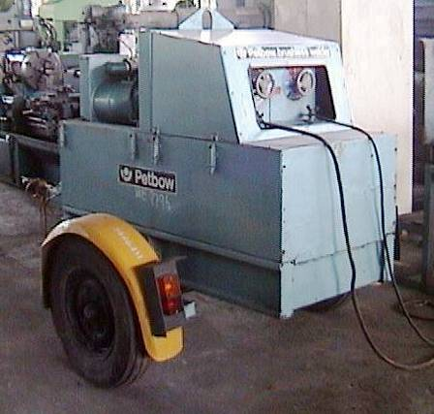
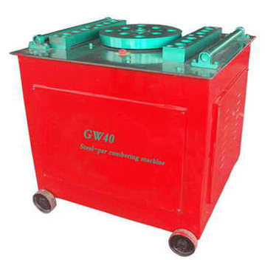
Construction Equipment

Slide 25
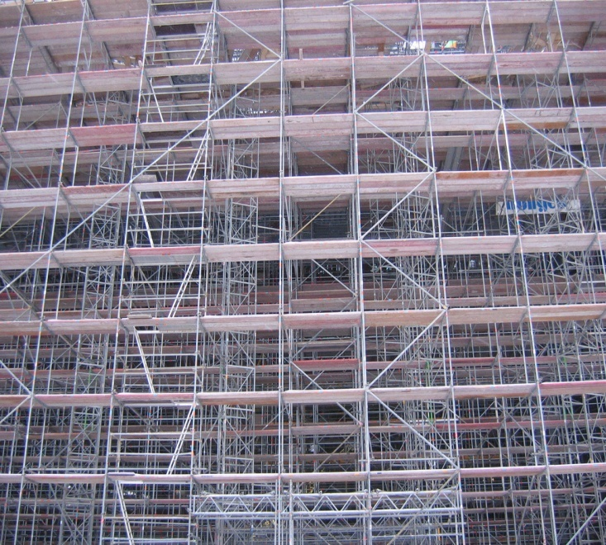






Slide 26
Equipment & Tool List owned by the Company
MACHINE SHOP
LATH MACHINE (10 FEETBED) 01
LATH MACHINE (08 FEETBED) 02
DRILLING EQUIPMENT
PORTABLE PILLER DRILL MACHINE UP TO 3” 03
PORTABLE MAGNETIC DRILL MACHINES UP TO 25mm 03
HAND DRILL MACHINES IN DEFFERENT SIZE 06
HILTI DRILL MACHINES 02
HANDLING FACILITIES
FORK LIFTERS 03
CRANE (KARO) WITH 194 LONG BOOM 25 Ton
OVERHEAD GANTRY CRANE 10 Ton
OVERHEAD GANTRY CRANE 05 Ton

Slide 27
Equipment & Tool List owned by the Company
SURFACE TREATMENT & PAINTING EQUIPMENT
SAND BLASTING EQUIPMENT COMPLETE WITH
COMPRESSOR ANS SAND POTS 02
AIR LESS SPRAY PAINT EQUIPMENT 01
BACKING OVEN 8’X8’X8’ 01
BENDING & ROLLING EQUIPMENT
PLATE BENDING MACHINE 10’X5/16” 01
PLATE ROLLING MACHINE 8’X3/4” 02
SHEET ROLLING MACHINE 4’X1/16” 01
SHEARING & PUNCHING EQUIPMENT
STRIGHT 8FT LENGTH 01
MANUAL OPERATED SHEAR 01
MECHANICAL PRESS 01
HYDROLIC PRESS / BANDING 01
INSULATION EQUIPMENT
PIPE BENDING MACHINE UP TO 4” 02
STEEL BAR BENDING MACHINE 01
WELDING EQUIPMENT
D.C. WELDING RECTIFIRES 300~400 AMP10
SPOT RESISTANCE WELDING MACHINE 01
PVC WELDING MACHINE 01
OXY ACETTLENE GAS WELDING SETS 05
GAS CUTTING EQUIPMENT
HAND OPERATED GAS CUTTING SETS 05
HEATING TORCH SETS 02

Slide 28
Equipment & Tool List owned by the Company
POWER GENERATION
500 KVA GENERATOR 01
40 KVA GENERATOR 01
10 KVA GENERATOR 01
GENERAL TOOLS
CRANE CAP 25 TON 02
WELDING PLANT (AC+DC) 80
SAND BLASTING COMPRESSOR 02
AUTO GAS CUTTER 04
MAGNETIC DRILL MACHINE 10
HYDRAULIC JACK (1 TO 20 TOS CAP) 05
ANGLE GRINDER 7” 150
GRINDER 4” 80
PEN GRINDER 15
PADESTAL DRILL MACHINE 3/8”&1” 03
CHAIN PULLY BLOCK 100
HAMMER METAL 10,5,2 POINTS 20
PIPE WRENCH 6”,8”,12”,16”,24” 30 EA
ADJUSTABLE 6”,8”,12”,16”,24” 30 EA
OPEN SPANER SET ¼” TO 2” 04 SET
RING SPANER SET ¼” TO 2” 04 SET
COMBINATION PLAIR 6”, 8” 20 EA
MISC. FACILITIES
HAND GRINDER 7” 15
BABY GRINDER 4” 15
PENCIL GRINDER 05
CHAIN BLOCK (2,3,5,10 TON) 20
HYDRAULIC JACK 20 TON 04
POWER HACK SAWS 01
HYDRO STATIC TEST PUMPS 03
CONCRETE MIXERS 02

Slide 29
Equipment & Tool List owned by the Company
GENERAL TOOLS (cont’d)
CENTRE PUNCH 20 EA
STAR SET 10 SET
HAND LEVEL 6”,12”24” 25 EA
RIGHTANGLE 6”,12”24” 35 EA
METER TAPE 50’, 100’ 10 EA
METER TAPE 10’, 15’ 150 EA
C CLAMP 4”,6”12” 10 EA
SIDE CUTTER 6”, 8” 10 EA
NOSE PLASS 6”, 8” 10 EA
HAKSAW FRAME 12” 20 EA
DRILL MACHINE 3/8” & 1” 08 EA
HILTI DRILL MACHINE 1/8” TO 1” 06 EA
DRILL BIT MASONARY & METAL 10 SET
CABLE KNIFE 10 EA
MULTI METER DIGITAL 15 EA
LN KEY 10 SET
GENERAL TOOLS (cont’d)
TUBE CUTTER 06 EA
TUBE BENDER ¼”, 3/8”,1/2” 08 EA
TEMPERATURE CALIBRATOR 01 EA
NUMATIC PUMP 01 EA
WATER HYDRAULIC PUMP 01 EA
JOFRA CALIBRATOR 01 EA
MILI SOURCE AMP 01 EA
FREQUENCY METER & GENERATE 01 EA
H.H.T HARD COMMUNICATOR 01 EA
ROSE MONT & YOKOGAWA 01 EA
DC POWER SUPPLY 01 EA

Slide 30
Equipment & Tool List owned by the Company
LIST OF FACILITIES TO SUPPORT (CONSTRUCTION
TEAM AT REMOTE SITE)
TOYOTA HILUX 02
MAZDA (PICKUP) 03
FURNISHED CONTAINER (OFFICE) WITH AIR
CONDITION (20’X10’X10’) 02
CONTAINER STORE (20’X10’X10’) 02
CONTAINER RESIDENTAIL
(20’X10’X10’) 03
WATER BOWZER CAPACITY 2000G 02
POWER GENERATION AS PER SITE REQUIREMENTS
MASS ON SITE 01
VEHICLES
TOYOTA HILUX 04
JEEP 02
CAR 04
MOTOR CYCLES 08
SCAFFOLDING MATERIAL
PIPE LENGTH 20FT 1000 EA (20000 RFT)
PIPE LENGTH 16FT 1200 EA (19200 RFT)
PIPE LENGTH 10FT 1200 EA (12000 RFT)
PIPE LENGTH 8FT 800 EA (6400 RFT)
WOODEN PLANKS LENGTH 10’, WIDTH 12” &
THICKNESS 2” 500 EA (5000 RFT)
PIPE CLAMPS 8000 EA
Temporary Equipment / Machinery other than mentioned above shall be hired as per requirement of project / projects

Slide 31

Ongoing & Completed Projects
Sr. No. | Client Name | Project Description | Contract No. | Contract Value | Completion Date | Location
1 | HAMZA POWER PLANT | ERECTION OF BOILER (150 TPH) |  | 92,063,400 | ONGOING | KHAN PUR
2 | CHANAR ENERGY LIMITED | Fabrication & Erection of Piping, Chimney, Tanks and Erection of Vessels |  | 57,500,000 | ONGOING | TANDLIAN WALA
3 | CHANAR ENERGY LIMITED | Erection of Bagasse Fuel System ,TG, Cooling Tower ,EOT Crane |  | 31,010,000 | ONGOING | TANDLIAN WALA
4 | CHANAR ENERGY LIMITED | ERECTION OF BOILER (115 TPH) | CEL/142 | 96,000,000 | ONGOING | TANDLIAN WALA
5 | HAMZA POWER PLANT | ERECTION OF BOILER (150 TPH) |  | 100,000,000 | 10-Feb-17 | KHAN PUR
6 | CHINIOT POWER LIMITED | ERECTION OF (155X2) | LOI/PAKASIA/BOILERX2/14/510 | 230,330,000 | 25-Jun-14 | CHINIOT
7 | CHINIOT POWER LIMITED | FABRICATION & ERECTION OF PIPING | LOI/PAKASIA/BOILERX2/14/511 | 200,000,000 |  | CHINIOT
8 | RYK POWER HOUSE | FABRICATION & ERECTION P11 PIPE LINE | PO-46 | 19,000,000.00 |  | Rahim Yar Khan
9 | RYK POWER HOUSE | FABRICATION & ERECTION CS,SS PIPE LINE | PO-211 | 19,140,000.00 |  | Rahim Yar Khan
10 | RYK POWER HOUSE | FABRICATION & ERECTION CS COOLING WATER PIPE LINE | PO-188 | 7,125,000.00 |  | Rahim Yar Khan
11 | HMC GHOTKI PROJECT | 1) Erection/instalation of structure & Auxiliary Equipment 2) Site Fabrication | HMC/PMD/140TPH-Boiler/ | 13,500,000.00 | 15-07-2013 | GHOTKI
12 | HMC GHOTKI PROJECT | Fabrication & Erection of piping work | HMC/PMD/140TPH-Boiler/ | 9,683,825.00 |  | GHOTKI

Slide 32

Ongoing & Completed Projects
Sr. No. | Client Name | Project Description | Contract No. | Contract Value | Completion Date | Location
13 | HMC GHOTKI PROJECT | Erection of Fuel & ash handling system | HMC/PMD/140TPH-Boiler/ | 9,683,825.00 |  | GHOTKI
14 | kunnar/kpd plant | ATA erection/fabrication piping | OGDCL/KUNNAR | 3,300,000 |  | Hyderabad
15 | Descon Eng.. Ltd | Erection of SS Storage Tank | DES/SC/7426/002 | 490,000.00 | 10-Dec-10 | FFCL Sadiq abad
16 | Descon Eng.. Ltd | Erection of SS Storage Tank | DES/SC/7426/001 | 480,000.00 | 1-Dec-10 | FFCL Sadiq abad
17 | Descon Eng. Ltd | Erection/Fabrication CS,SS,piping,& Pipe Support | PC&S/1134/SC/M/001(Rev-01) | 33,450,000 | 12-Oct-10 | FFCL Sadiq abad
18 | Descon Eng.. Ltd | Supply of Manpower | DES/SC/1121/M/306 | 78,827 | 24-Nov-10 | Engro Chemical Dharki
19 | Descon Eng.. Ltd | Fabrication of SS,CS & Pipe Support & Rolling Pad | PC&S/1121/SC/M/154(Rev-01) | 10,400,000 | 6-Nov-10 | Engro Chemical Dharki
20 | Descon Eng.. Ltd | Fabrication & Erection of steel structure | PC&S/1134/SC/M/006 | 10,500,000 | 22-Oct-10 | FFCL Sadiq abad
21 | Descon Eng.. Ltd | Fabrication,Erection,CS.SS.Duct & Chute | DES/SC/1134/M/029 | 320,000 | 4-Sep-10 | FFCL Sadiq abad
22 | Descon Eng.. Ltd | Fabrication of SS,CS & Pipe Support | DES/SC/1121/M/264 | 9,350,000 | 4-Sep-10 | Engro Chemical Dharki
23 | Descon Eng.. Ltd | Supply of Manpower | DES/SC/1121/M/252 | 351,886 | 28-Aug-10 | Engro Chemical Dharki

Slide 33
Ongoing & Completed Projects
Sr. No. | Client Name | Project Description | Contract No. | Contract Value | Completion Date | Location
24 | Descon Eng.. Ltd | Supply of Manpower | DES/SC/1121/M/241 | 140,282 | 12-Aug-10 | Engro Chemical Dharki
25 | Descon Eng.. Ltd | Supply of Manpower | DES/SC/1121/M/240 | 115,304 | 11-Aug-10 | Engro Chemical Dharki
26 | Descon Eng.. Ltd | Supply of Manpower | DES/SC/1121/M/239 | 701,854 | 11-Aug-10 | Engro Chemical Dharki
27 | Descon Eng.. Ltd | Supply of Manpower | DES/SC/1121/M/238 | 292,045 | 11-Aug-10 | Engro Chemical Dharki
28 | Descon Eng.. Ltd | Supply of Manpower | DES/SC/1121/M/221 | 74,313 | 15-Jul-10 | Engro Chemical Dharki
29 | Descon Eng.. Ltd | Supply of Manpower | DES/SC/1121/M/220 | 320,160 | 15-Jul-10 | Engro Chemical Dharki
30 | Descon Eng.. Ltd | Supply of Manpower | DES/SC/1121/M/198 | 586,932 | 15-Jun-10 | Engro Chemical Dharki
31 | Descon Eng.. Ltd | Supply of Manpower | DES/SC/1121/M/196 | 333,919 | 9-Jun-10 | Engro Chemical Dharki
32 | Descon Eng.. Ltd | Supply of Manpower | DES/SC/1121/M/195 | 450,936 | 9-Jun-10 | Engro Chemical Dharki

Slide 34
Ongoing & Completed Projects
Sr. No. | Client Name | Project Description | Contract No. | Contract Value | Completion Date | Location
33 | Descon Eng.. Ltd | Supply of Manpower | DES/SC/1121/M/191 | 146,160 | 26-May-10 | Engro Chemical Dharki
34 | Descon Eng.. Ltd | Supply of Manpower | DES/SC/1121/M/217 | 200,535 | 14-May-10 | Engro Chemical Dharki
35 | Descon Eng.. Ltd | Supply of Manpower | DES/SC/1121/M/184 | 480,473 | 13-May-10 | Engro Chemical Dharki
36 | Descon Eng.. Ltd | Fabrication & Erection of steel structure | PC&S/1134/SC/M/005 | 7,800,000 | 6-Jul-10 | FFCL Sadiq abad
37 | Descon Eng.. Ltd | instalation of GRP Pipe work | DES/1121/SC/M/007 | 20,774,725 | 4-May-10 | Engro Chemical Dharki
38 | Descon Eng.. Ltd | Erection of Hoppers | DES/SC/1121/M/170 | 1,430,000 | 16-Apr-10 | Engro Chemical Dharki
39 | Descon Eng.. Ltd | Fabrication CS,SS,AS,Piping,&Pipe Support | PC&S/1134/SC/M/001 | 31,350,000 | 9-Mar-10 | FFCL Sadiq abad
40 | Descon Eng.. Ltd | Fabrication of Rackway stoper | DES/SC/1121/120 | 225,000 | 2-Mar-10 | Engro Chemical Dharki
41 | Descon Eng.. Ltd | Erection of steel structure | PC&S/1131/SC/M/006 | 3,750,000 | 1-Feb-10 | Engro Chemical Dharki

Slide 35
Ongoing & Completed Projects
Sr. No. | Client Name | Project Description | Contract No. | Contract Value | Completion Date | Location
42 | Descon Eng.. Ltd | Fabrication CS,SS,AS,Clamps | PC&S/1121/SC/M/135 | 2,020,633 | 24-Dec-09 | Engro Chemical Dharki
43 | Descon Eng.. Ltd | Fabrication & Erection of Steel Structure of Ammonia Tank | PC&S/1121/SC/M/128 | 8,530,000 | 17-Dec-09 | Engro Chemical Dharki
44 | Descon Eng.. Ltd | Fabrication of Structure (Releated to Ammonia Storage Tank) | DES/SC/1121/M/122 | 760,000 | 23-Nov-09 | Engro Chemical Dharki
45 | Descon Eng.. Ltd | Erection of Cable Tray | PC&S/1121/SC/M/121 | 750,000 | 22-Nov-09 | Engro Chemical Dharki
46 | Descon Eng.. Ltd | Fabrication & Erection of Steel Structure of Ammonia Tank | PC&S/1121/SC/M/128 (REV-01) | 5,970,000 | 15-Oct-09 | Engro Chemical Dharki
47 | Descon Eng.. Ltd | Fabrication Fillter Plant | PC&S/1121/SC/M/069 | 133,950 | 11-Oct-09 | Engro Chemical Dharki
48 | Descon Eng.. Ltd | Plate Rolling for Tank | PC&S/1121/SC/M/066 | 500,000 | 8-Oct-09 | Engro Chemical Dharki
49 | Descon Eng.. Ltd | Fabrication CS,SS,AS,Pipe Support &Rolling of Pads for pipe support | PC&S/1121/SC/M/154 | 6,619,000 | 16-Sep-09 | Engro Chemical Dharki
50 | Descon Eng.. Ltd | Fabrication of steel structure | PC&S/1131/SC/M/005 | 5,625,000 | 16-Sep-09 | Engro Chemical Dharki

Slide 36
Ongoing & Completed Projects
Sr. No. | Client Name | Project Description | Contract No. | Contract Value | Completion Date | Location
51 | Fatima Fertilizer Company Ltd | Bending / Fabrication of Structural Steel for Fabrication / Erection of Water Storage Tanks | JO-642/08 | 393,103 | 25-Aug-09 | Sadiq Abad
52 | Descon Eng.. Ltd | Fabrication of Hoppers | PC&S/1121/SC/M/149 | 5,535,000 | 20-Aug-09 | Engro Chemical Dharki
53 | Descon Eng.. Ltd | Steel Structure shed for HPE yard Building | PC&S/2212/SC/M/028 | 16,667,815 | 20-Aug-09 | UCH POWER PROJECT DAIRA MURAD JAMALI
54 | Descon Eng.. Ltd | Fabrication Steel Structure & Sand blasting Painting | PC&S/1121/SC/M/146 | 5,625,000 | 10-Aug-09 | Engro Chemical Dharki
55 | Descon Eng.. Ltd | Fabrication of SS,CS & AS Pipe Support With Clamps | DES/SC/1121/M/030 | 4,973,000 | 17-Jul-09 | Engro Chemical Dharki
56 | Descon Eng.. Ltd | Supply & Fabrication of counter Saddles E-504,506,508 | DES/SC/1121/M/017 | 687,500 | 17-Jul-09 | Engro Chemical Dharki
57 | Descon Eng.. Ltd | Plate Rolling Work for Tank | DES/SC/1121/M/028 | 1,000,000 | 10-Jul-09 | Engro Chemical Dharki
58 | SKB Engg.& Construction | HVAC pre- insulated chiled water supply &Return pipes . | P.O. # 0233 | 279,835,131 | 22-Jun-09 | Shahbaz Air Base
59 | Descon Eng.. Ltd | Fabrication of Spacer Ring | PC&S/1121/SC/M/015 | 960,000 | 12-Jun-09 | Engro Chemical Dharki

Slide 37
Ongoing & Completed Projects
Sr. No. | Client Name | Project Description | Contract No. | Contract Value | Completion Date | Location
60 | Descon Eng.. Ltd | Plate Rolling Work for Tanks | DES/SE/1121/M/014 | 1,000,000 | 4-Jun-09 | Engro Chemical Dharki
61 | Descon Eng.. Ltd | Fabrication of Cable Tray support structure including sand blasting with one coat of Primer | PC&S-SUBCO/FRM-118 | 12,000,000 | 2-Feb-09 | Engro Chemical Dharki
62 | Descon Eng.. Ltd | Fabrication Of M/S Plate With Material | DES/SC/1121/M/009 | 24,440 | 5-Dec-08 | Engro Chemical Dharki
63 | Descon Eng.. Ltd | Fabrication and Sand Blasting of Handrail For Prilling tower | DES/SC/1121/M/002 | 150,000 | 15-Nov-08 | Engro Chemical Dharki
64 | Fatima Fertilizer Company Ltd | Rolling of sheets | JO-798/08 | 12,400 | 1-Nov-08 | Sadiq Abad
65 | Fatima Fertilizer Company Ltd | Embedded Steel Plates / Rods for O&U Pipe Sleeves | JO-847/08 | 95,520 | 25-Oct-08 | Sadiq Abad
66 | Fatima Fertilizer Company Ltd | Embedded Steel Plates/Roads for O&U Pipe Sleeves | JO-716/08 | 34,800 | 13-Oct-08 | Sadiq Abad
67 | Descon Eng.. Ltd | Rolling Of Rapping Plates of Various Diameter | DES/SE/1121/M/001 | 371,000 | 1-Sep-08 | Engro Chemical Dharki
68 | Fatima Fertilizer Company Ltd | Rolling of SS Sheet for Repair of H-113 A-D | JO-555/08 | 3,066 | 24-Jul-08 | Sadiq Abad
69 | Descon Eng.. Ltd | Fabrication and Welding works of all piping materials and thickness |  | 90,000 Qrs. | 1-Apr-08 | Qatar

Slide 38
Ongoing & Completed Projects
Sr. No. | Client Name | Project Description | Contract No. | Contract Value | Completion Date | Location
70 | Ghotki Sugar Mills (Pvt.) Ltd | Fabrication and Erection | 353/MECH /HO/GSM/07 | 1,685,090 | 7-Oct-07 | Ghotki
71 | United Sugar Mills Limited | Erection, Installation and Fabrication | LPO # 120- | 1,180,000 | 20-Jun-06 | Rahim Yar Khan
72 | Bestway Cement Ltd | Fabrication of Misc. Steel Structure for Sack Store Shed Erection | BCL/Mech/Fab /Erect/PAE/140 | 1,540,000 | 23-May-06 | Chakwal
73 | CBMC – BCL | Fabrication & Erection for Day Tank of Bestway Project Fuel Oil System | CBMC-PA-01- | 1,150,000 | 17-May-06 | Chakwal
74 | Bestway Cement Ltd | Cleaning & Painting | BCL/CH/Mech/04/34 | 299,200 | 29-Apr-06 | Chakwal
75 | Descon Eng.. Ltd | Fabrication of Steel Srtucture | PC&S/1109 /SC/M/025(REV) | 4,500,000 | 27-Jan-06 | Pakistan CementChakwal
76 | Haleeb Foods Limited | Fabrication of tank & Piping |  | 78,000 | 29-Jul-05 | Rahim Yar Khan
77 | Descon Eng.. Ltd | Fabrication of Steel Srtucture | LOA-CCCL- FAB-007 | 2,250,000 | 15-Jul-05 | Chakwal Cement
78 | JDW Sugar Mills Ltd | Fabrication and Erection Truess & G.I Sheet | LPO#73 | 182,000 | 28-Apr-05 | Rahim Yar Khan

Slide 39
Ongoing & Completed Projects
Sr. No. | Client Name | Project Description | Contract No. | Contract Value | Completion Date | Location
79 | JDW Sugar Mills Ltd | Pipe Fabrication and Erection Complete with Supports | LPO#32 | 3,000,000 | 23-Feb-05 | Rahim Yar Khan
80 | JDW Sugar Mills Ltd | Fabrication and Installation pipe and pump | LPO#591 | 650,000 | 13-Dec-04 | Rahim Yar Khan
81 | JDW Sugar Mills Ltd | Fabrication of Steel Structure Platform | LPO#375- | 450,000 | 9-Dec-04 | Rahim Yar Khan
82 | JDW Sugar Mills Ltd | Fabrication and Erection of Gangway Platform and supporting structure | LPO#546 | 1,050,000 | 25-Oct-04 | Rahim Yar Khan
83 | JDW Sugar Mills Ltd | Fabrication and Installation pipe and pump | LPO#547 | 260,000 | 25-Oct-04 | Rahim Yar Khan
84 | JDW Sugar Mills Ltd | Steel Trusses Fabrication Work | LPO#542 | 560,000 | 5-Oct-04 | Rahim Yar Khan
85 | JDW Sugar Mills Ltd | Fabrication of Steel Structure and Gangway Platform | LPO#504 | 350,000 | 21-Sep-04 | Rahim Yar Khan

Slide 40
QHSE
HSE Management Approach
1. Leadership & Commitment
2. Policy & Strategic Objectives
3. Organization, Resources and Competence
4. Risk Evaluation and Management
5. Planning, Standards, Procedures & Documents
Corrective Action
Monitoring & Performance Measurement
6. Implementation
7. Audit
Feedback
8. Management Review
Improvement

Slide 41
QHSE
HSE Monitoring
HSE Recordables
Lost-time due to Injury (LTI) Frequency Rate
Medical Treatment Incident (MTI) Frequency Rate
Management Commitment
Management Team participation in Tool-Box Talks
First Aid (FA) Frequency Rate
Management Team involvement in HSE Trainings
HSE Training Man-days
Environmental Accidents Frequency Rate
HSE Review Meetings
Regulatory Compliances (Occupational Health, Safety, & Environment)
Contractor HSE Development Initiatives
Near miss Reporting
Response and improvement initiatives based on Near miss & Incident Reports
Communication & Training
HSE Audits & Inspections
Emergency Response Drills conducted
Energy & Waste Reduction ratios
  Management Team participation in Tool-Box Talks
  Management Team involvement in HSE Trainings
  HSE Training Man-days
  HSE Bulletins & Flyers

Slide 42
QHSE
Employee HSE Targets - Incentives
Health
Zero occupational illnesses
Safety
Personal Protective Equipment Compliance
Environment
Zero environmental accidents
Zero HSE Warning
General Behavior
Reporting of occupational health hazards
Zero First Aid case
Reporting of environmental hazards and near-misses
Zero LTI
Near-miss Reporting
  Personal Conduct
  Housekeeping

Slide 43
QHSE
Employee HSE Targets - Accountability
Health
No reporting of occupational health hazards
Safety
Non-compliance of Personal Protective Equipment
No near-miss reported
Environment
Causing environmental accident(s)
Work carried out without Permit
General Behavior
Non-adherence to Lockout/ Tagout Procedure
  Horseplay
  Poor Housekeeping
  Non-adherence to Alcohol & Drugs policy

Slide 44
QHSE
Lessons learnt
    Project HSE plan implementation through an Integrated management committee
    PPEs at all times
    Awareness of all permit to work systems through induction orientation
    Scaff-tag system implementation
    Fire protection and breathing training
    Waste segregation and disposal
    Regular safety inspections/ audits
    JSA for equipment operations, heavy lifts and battery limit isolations
    Daily Toolbox talk
    Uncompromised focus on Safety Observations and near misses
    Train, Train and Train
    Only certified equipment and tools
    Experience has value only if one learns from it!

Slide 45












Client
CBMC
Ghotki sugar mills
united sugar mills

Slide 46

Exceeding expectations
Pak Asia
Your Right Choice
To create harmonious environment and to render excellent service conscientiously to our friends all over the world
Thank you

